Slide 1
MongoDB Development in .NET

Slide 2
Contents
MongoDB .NET essentials
CRUD operations
Working with POCOs
Demo folder: 05-MongoDB-DotNet

Slide 3
1. MongoDB .NET Essentials
Overview
Installing NuGet packages for MongoDB
Reviewing installed assemblies
MongoDB .NET Driver API documentation
Connecting to a MongoDB instance
Getting a handle to a database
Getting a collection
MongoDB documents in .NET

Slide 4
Overview
You can use .NET to access MongoDB databases, via the following 3 NuGet packages…
MongoDB.Bson
Handles conversions of .NET classes to/from BSON
MongoDB.Driver.Core
The actual MongoDB driver
Handles connections/communications with a MongoDB instance
MongoDB.Driver
Provides an easy-to-use API on top of the core component driver
Synchronous and asynchronous methods
Also supports LINQ queries, very cool!

Slide 5
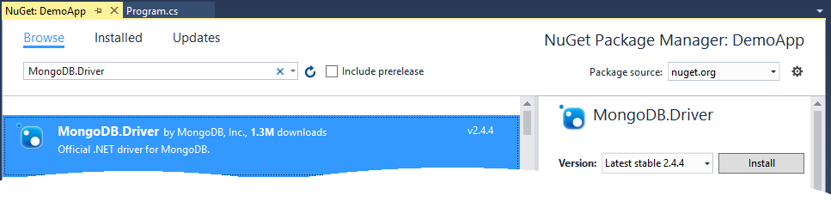
Installing NuGet Packages for MongoDB
Just install the MongoDB.Driver package
It depends on MongoDB.Driver.Core and MongoDB.Bson
So these other 2 packages will also be installed automatically
Example
See the DemoApp project

Slide 6
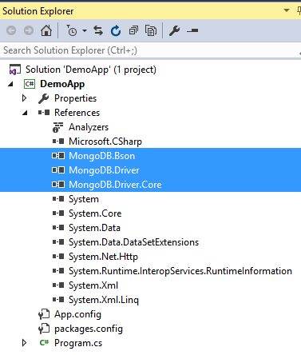
Reviewing Installed Assemblies
You can see the installed assemblies in the project

Slide 7
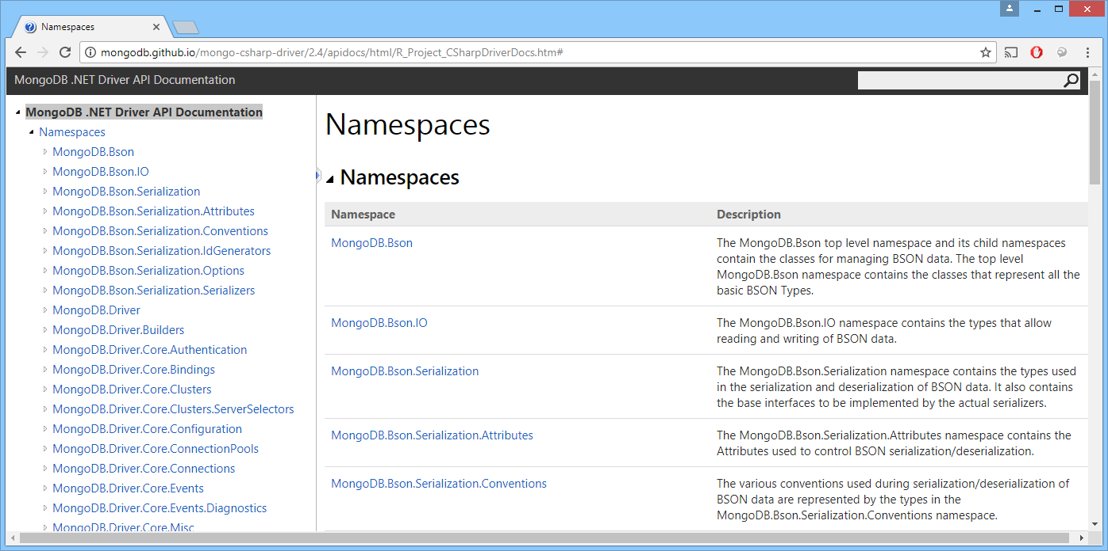
MongoDB .NET Driver API Documentation
The MongoDB .NET API is similar to the MongoDB JS API, but it's statically typed. For details, see:
http://mongodb.github.io/mongo-csharp-driver/2.4/apidocs/html/ R_Project_CSharpDriverDocs.htm

Slide 8
Connecting to a MongoDB Instance
Assume you already have a MongoDB instance running
E.g. by running mongod.exe, as discussed in earlier chapters
You can connect to the MongoDB instance in .NET
Via the MongoClient class
using MongoDB.Driver;
…
private static void DemoConnect()
{
// Connect to MongoDB instance on the default host and port.
var client1 = new MongoClient();
// Or connect to a specific host and port via a connection string.
var client2 = new MongoClient("mongodb://localhost:27017");
// Or connect to a specific host and port via a URL.
var client3 = new MongoClient(MongoUrl.Create("mongodb://localhost:27017"));
Console.WriteLine("client1: {0}", client1);
Console.WriteLine("client2: {0}", client2);
Console.WriteLine("client3: {0}", client3);
}
Program.cs

Slide 9
Getting a Handle to a Database
.NET languages are statically typed (unlike JS or Python)
You must use strongly typed methods/properties to get artifacts
E.g. call ListDatabases() to get all the databases
E.g. call GetDatabase(name) to get a particular database
private static void DemoDatabases()
{
var client = new MongoClient();
// Get a list of all the databases.
var databases = client.ListDatabases().ToList();
Console.WriteLine("Database names:");
foreach (var database in databases)
{
Console.WriteLine("\t{0}", database);
}
// Get the "test" database.
var testDb = client.GetDatabase("test");
Console.WriteLine("testDb database namespace: {0}", testDb.DatabaseNamespace);
}
Program.cs

Slide 10
Getting a Collection
You can get a collection in the database as follows:
Notes:
You must call GetCollection() to get a collection, because .NET languages are statically typed
You can use BsonDocument to represent BSON documents, see next slide for details
private static void DemoCollections()
{
var client = new MongoClient();
var db = client.GetDatabase("test");
// Get the "people" collection, as an IMongoCollection<BsonDocument>.
var people = db.GetCollection<BsonDocument>("people");
Console.WriteLine("people: {0}", people);
}
Program.cs

Slide 11
MongoDB Documents in .NET (1 of 2)
In .NET, a MongoDB document can be represented as a BsonDocument object
Defined in the MongoDB.Bson package
The MongoDB.Bson package defines .NET classes to represent all the BSON types
BsonValue - Abstract base class for all BSON types
BsonString - BSON string value
BsonInt32 - BSON 32-bit integer
BsonObjectId - BSON ObjectId value
BsonArray - BSON array
etc…
You can also define POCO classes to represent documents
See Section 3 in this chapter

Slide 12
MongoDB Documents in .NET (2 of 2)
Here's a simple example of a BSON document in C#:
using MongoDB.Bson;
…
private static void DemoDocuments()
{
// Create a BsonDocument using C# initializer syntax.
var doc1 = new BsonDocument
{
{ "name", new BsonString("Jayne") },
{ "age", new BsonInt32(52) },
{ "gender", new BsonString("F") },
{ "langs", new BsonArray(new[] {"English", "French"}) }
};
// Create an empty BsonDocument first, and then add fields via Add().
var doc2 = new BsonDocument();
doc2.Add("name", new BsonString("Tom"));
doc2.Add("age", new BsonInt32(20));
…
// Create an empty BsonDocument first, and then add fields via the [] indexer.
var doc3 = new BsonDocument();
doc3["name"] = new BsonString("Emily");
doc3["age"] = new BsonInt32(20);
…
}
Program.cs

Slide 13
2. CRUD Operations
Overview
Creating documents
Reading documents
Updating documents
Deleting documents

Slide 14
Overview
In this section, we show how to perform CRUD operations based on BsonDocument collections
Preferred approach if collection contains heteregeneous documents
i.e. some documents contain different fields
In Section 3, we show how to perform CRUD operations based on POCO classes
Preferred approach if collection contains homogeneous documents
i.e. all documents have the same fields

Slide 15
Creating Documents
To create documents in a collection, call:
InsertOne() or InsertOneAsync()
InsertMany() or InsertManyAsync()
Here's a synchronous example
For the async equivalent, see DemoCreateAsync()
private static void DemoCreate()
{
var client = new MongoClient();
var db = client.GetDatabase("test");
var people = db.GetCollection<BsonDocument>("people");
var doc1 = new BsonDocument{…};
people.InsertOne(doc1);
var listOfDocs = new List<BsonDocument>
{
new BsonDocument{…},
new BsonDocument{…}
};
people.InsertMany(listOfDocs);
}
Program.cs

Slide 16
Reading Documents - Overview
To read documents in a collection, call:
FindSync(), FindAsync(), or Find()
FindSync() and FindAsync() return an IAsyncCursor
MongoDB returns a query result in batches
First batch is 1MB in size, subsequent batches are 4MB
You use the IAsyncCursor to iterate through the batches
Find() returns an IFindFluent - see later for details
IAsyncCursor<TProjection> FindSync<TProjection>(
FilterDefinition<TDocument> filter,
FindOptions<TDocument, TProjection> opts = null,
CancellationToken token = null)
Task<IAsyncCursor<TProjection>> FindAsync<TProjection>(
FilterDefinition<TDocument> filter,
FindOptions<TDocument, TProjection> opts = null,
CancellationToken token = null)

Slide 17
Reading Documents - Read All Documents
Here's a synchronous query
For the async equivalent, see DemoReadAsync()
private static void DemoRead()
{
var client = new MongoClient();
var db = client.GetDatabase("test");
var people = db.GetCollection<BsonDocument>("people");
// Create an empty filter, i.e. find all documents in the collection.
FilterDefinition<BsonDocument> filter = FilterDefinition<BsonDocument>.Empty;
// Synchronously find all documents. The results are returned in batches.
using (IAsyncCursor<BsonDocument> cursor = people.FindSync(filter))
{
// Get the next batch in the result set.
while (cursor.MoveNext())
{
// Iterate through all documents in the current batch.
IEnumerable<BsonDocument> batch = cursor.Current;
foreach (BsonDocument doc in batch)
{
Console.WriteLine(doc);
}
}
}
}
Program.cs

Slide 18
Reading Documents - Filtering (1 of 3)
The FindXxx() methods take a filter as the 1st param
The filter specifies which documents you want to retrieve
You can specify the filter in various ways:
As a JSON string (same as you do in JS in the MongoDB Shell)
As a BsonDocument object
Using the FilterDefinitionBuilder class
Using the Builders class
string filter1 = "{ age: {'$gt': 30} }";
BsonDocument filter2 = new BsonDocument("age", new BsonDocument("$gt", 30));
var filter3 = new FilterDefinitionBuilder<BsonDocument>().Gt("age", 30);
var filter4 = Builders<BsonDocument>.Filter.Gt("age", 30);

Slide 19
Reading Documents - Filtering (2 of 3)
This example shows how to use filters
You can use filter1, filter2, filter3, or filter4 here
private static void DemoReadFilterSimple()
{
var client = new MongoClient();
var db = client.GetDatabase("test");
var people = db.GetCollection<BsonDocument>("people");
// Create a filter as a string.
var filter1 = "{ age: {'$gt': 30} }";
// Create a filter as a BsonDocument.
var filter2 = new BsonDocument("age", new BsonDocument("$gt", 30));
// Create a filter using the FilterDefinitionBuilder class.
var filter3 = new FilterDefinitionBuilder<BsonDocument>().Gt("age", 30);
// Create a filter using the Builders class.
var filter4 = Builders<BsonDocument>.Filter.Gt("age", 30);
using (IAsyncCursor<BsonDocument> cursor = people.FindSync(filter1))
{
// Iterate through results as normal…
}
}
Program.cs

Slide 20
Reading Documents - Filtering (3 of 3)
You can write complex filters
Comprising multiple field values, and/or/not logic, etc.
Example - find people younger than 20 or older than 30
See DemoReadFilterComplex()
var filter1 = "{ '$or': [ { age: {'$lt': 20} }, { age: {'$gt': 30} } ] }";
var filter2 = new BsonDocument("$or",
new BsonArray() {
new BsonDocument("age", new BsonDocument("$lt", 20)),
new BsonDocument("age", new BsonDocument("$gt", 30))
});
var filter3 = new FilterDefinitionBuilder<BsonDocument>().Or(
new[] {
new FilterDefinitionBuilder<BsonDocument>().Lt("age", 20),
new FilterDefinitionBuilder<BsonDocument>().Gt("age", 30)
});
var builder = Builders<BsonDocument>.Filter;
var filter4 = builder.Lt("age", 20) | builder.Gt("age", 30);

Slide 21
Reading Documents - Specifying Options
The FindXxx() methods take an optional FindOptions object as the 2nd param
Allows you to specify options to control the query
E.g. the number of documents to return in each batch
E.g. whether cursor should timeout (default timeout after 10 mins)
Example
Find 12 oldest people, in batches of 5, name and age only
See DemoReadWithFindOptions()
FindOptions<BsonDocument> options = new FindOptions<BsonDocument>
{
BatchSize = 5, // Get 5 docs in each batch.
NoCursorTimeout = true, // Cursor doesn't timeout.
Limit = 12, // Only get 12 docs.
Sort = "{ age: -1 }", // Sort by age (-1=>desc, +1=>asc).
Projection = "{ name: 1, age: 1, _id: 0}" // Include name and age only.
};

Slide 22
Reading Documents - Fluent API (1 of 2)
So far we've discussed FindSync() and FindAsync()
These methods return an IAsyncCursor, which you iterate over
Now we're going to look at Find()
Returns an IFindFluent, which supports a fluent API
Offers a simple syntax for Count, Sort, Limit, Skip etc.
IFindFluent Find(FilterDefinition<TDocument> filter, FindOptions = null)

Slide 23
Reading Documents - Fluent API (2 of 2)
Example
private static void DemoReadFluent()
{
var client = new MongoClient();
var db = client.GetDatabase("test");
var people = db.GetCollection<BsonDocument>("people");
// Find all documents as a list.
Console.WriteLine("Get results via ToList()");
var list = people.Find(FilterDefinition<BsonDocument>.Empty)
.Limit(12)
.Sort("{age: -1}")
.Project("{ name: 1, age: 1, _id: 0}");
Console.WriteLine("Results via ToList()");
foreach (var doc in list.ToList())
{
Console.WriteLine(doc);
}
Console.WriteLine("Results via ForEachAsync()");
list.ForEachAsync(doc => Console.WriteLine(doc));
}
Program.cs

Slide 24
Updating Documents - Overview
To update documents in a collection, call:
UpdateOne() or UpdateOneAsync()
UpdateMany() or UpdateManyAsync()
ReplaceOne() or ReplaceOneAsync()
Signatures for UpdateOne() and UpdateOneAsync():
Note:
UpdateMany() and UpdateManyAsync() have same signature
ReplaceOne() takes a document, not an UpdateDefinition
UpdateResult UpdateOne(FilterDefinition<TDocument> filter,
UpdateDefinition<TDocument> update,
UpdateOptions opts = null,
CancellationToken token = null)
Task<UpdateResult> UpdateOneAsync(FilterDefinition<TDocument> filter,
UpdateDefinition<TDocument> update,
UpdateOptions opts = null,
CancellationToken token = null)

Slide 25
Updating Documents - Example
The UpdateXxx() methods take an UpdateDefinition object as the 2nd param
Specifies the update(s) you want to perform
You can specify the update term in various ways
As a JSON string
As a BsonDocument object
Using the UpdateDefinitionBuilder class
Using the Builders class
Example - specifying the update term as a string
See DemoUpdate() for an example of all techniques
Program.cs
var filter1 = "{ name: 'Jayne' }";
var update1 = "{ $set: { name: 'JAYNE', favTeam: 'Swans' } }";
people.UpdateOne(filter1, update1);

Slide 26
Deleting Documents - Overview
To delete documents in a collection, call:
DeleteOne() or DeleteOneAsync()
DeleteMany() or DeleteManyAsync()
Signatures for DeleteOne() and DeleteOneAsync():
Note:
DeleteMany() and DeleteManyAsync() have same signature
DeleteResult DeleteOne(FilterDefinition<TDocument> filter,
CancellationToken token = null)
Task<DeleteResult> DeleteOneAsync(FilterDefinition<TDocument> filter,
CancellationToken token = null)

Slide 27
Updating Documents - Example
The DeleteXxx() methods take a filter as the 1st param
Same as for the FindXxx() and UpdateXxx() methods
Specify in the usual ways
Example - specifying the filter as a string
See DemoDelete() for an example of all techniques
Program.cs
var filter1 = "{ name: 'Wilfried' }";
people.DeleteMany(filter1);

Slide 28
3. Working with POCOs
Overview
Defining a POCO class
Using POCOs with MongoDB collections
Using LINQ

Slide 29
Overview
If all documents in a collection contain the same fields…
You can define a POCO class to represent the document
Advantages:
You can use regular .NET types for properties, e.g. string, int
You can define additional methods to manipulate documents
You can use strongly-typed LINQ queries
Disadvantages:
All documents in a collection must have the same schema

Slide 30
Defining a POCO Class (1 of 2)
To define a POCO class to represent a MongoDB document:
Define a regular POCO class
Define an ObjectId property, to represent the document's _id
Define properties for the fields in the document, using .NET types
You can customise the BSON serialization process, via attributes in MongoDB.Bson.Serialization.Attributes
[BsonId] - designate the _id field
[BsonElement] - specify different name for a field
[BsonIgnore] - don't serialize to/from BSON
[BsonIgnoreIfNull] - don't serialize to/from BSON if null
etc.

Slide 31
Defining a POCO Class (2 of 2)
Here's an example POCO class
using MongoDB.Bson;
using MongoDB.Bson.Serialization.Attributes;
…
class Person
{
[BsonId]
public ObjectId PersonId { get; set;}
public string Name { get; set; }
public int Age { get; set; }
public String Gender { get; set; }
[BsonElement("Langs")]
public IEnumerable<String> LanguagesSpoken { get; set; }
[BsonIgnore]
public DateTime Timestamp { get; set; } = DateTime.Now;
public override string ToString()
{
return $"[{PersonId}] {Name} Age: {Age} … … …";
}
}
Person.cs

Slide 32
Using POCOs with MongoDB Collections
You can use POCOs with MongoDB collections
Use your POCO as the type parameter, instead of BsonDocument
private static void DemoPocos()
{
var client = new MongoClient();
var db = client.GetDatabase("test");
var people = db.GetCollection<Person>("peopleDotNetPocos");
var person1 = new Person
{
Name = "Jayne",
Age = 52,
Gender = "F",
LanguagesSpoken = new List<string> { "English", "French" }
};
people.InsertOne(person1);
// Also see demo code, for an example of InsertMany().
// …
var list = people.FindSync(FilterDefinition<Person>.Empty).ToList();
foreach (var doc in list)
{
Console.WriteLine(doc);
}
}
Program.cs

Slide 33
Using LINQ - Overview
When you define strongly-typed POCO classes to represent documents, you can query the documents using LINQ
Import this namespace:
MongoDB.Driver.Linq
Call AsQueryable() on your MongoDB POCO collection
Returns an IMongoQueryable<T>, which supports LINQ

Slide 34
Using LINQ - Example
Here's an example of how to execute LINQ queries on a MongoDB POCO collection
using MongoDB.Driver.Linq;
…
private static void DemoLinq()
{
var client = new MongoClient();
var db = client.GetDatabase("test");
var people = db.GetCollection<Person>("peopleDotNetPocos");
var query = from p in people.AsQueryable()
where p.Age < 20 || p.Age > 30
orderby p.Age descending
select new { p.Name, p.Age };
Console.WriteLine("Matching Person objects:");
foreach (var doc in query)
{
Console.WriteLine(doc);
}
}
Program.cs

Slide 35
Any Questions?

